Slide 1
Access to High Performance Computing Infrastructure Computing opportunities for both new and experienced HPC users
Rasmus Berg Jensen
EuroHPC Competence Center Denmark

Slide 2
Content
Who am I?
What is HPC?
Why HPC?
HPC Landscape
Five HPC Infrastructures
Getting resources
Support

Slide 3
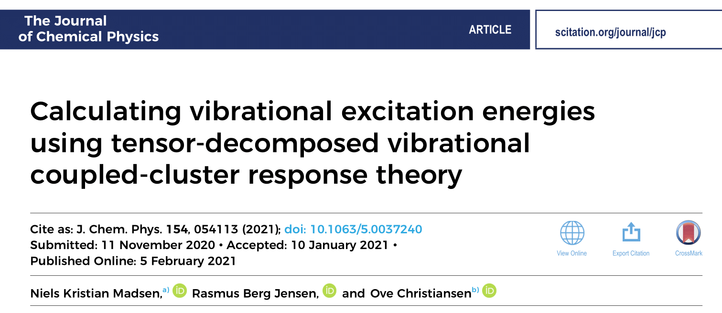
Who am I?
MSc in Physics
Facilitator
DeiC

Slide 4
Content
Who am I?
What is HPC?
Why HPC?
HPC Landscape
Five HPC Infrastructures
Getting resources
Support

Slide 5
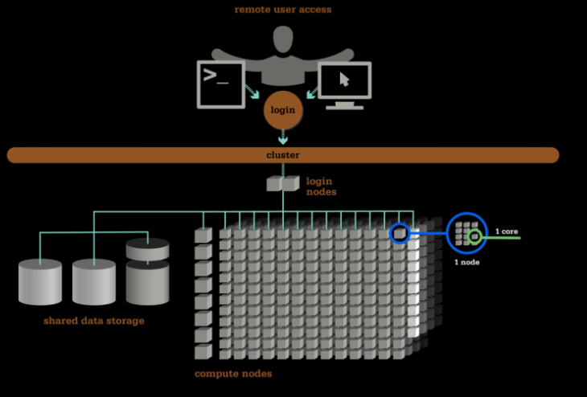
What is HPC
Large network of computing, storage and memory hardware
Multiple ”nodes” of hardware configured to work together
Dedicated software to exploit hardware remotely
From osc.edu

Slide 6
Content
Who am I?
What is HPC?
Why HPC?
HPC Landscape
Five HPC Infrastructures
Getting resources
Support

Slide 7
Student Project Example
Why HPC?
Question: can weaver ants protect mango orchards from fruit flies?
Method: statistical data analysis
Occupies PC
PC Runtime $\sim$ 1 week

Slide 8
Student Project Example
Why HPC?
Question: can weaver ants protect mango orchards from fruit flies?
Method: statistical data analysis
Frees PC
HPC Runtime: potentially faster

Slide 9
Content
Who am I?
What is HPC?
Why HPC?
HPC Landscape
Five HPC Infrastructures
Getting resources
Support

Slide 10
Infrastructure layers
HPC landscape
Local HPC
grendel@cscaa.dk
Reserved space through your grant funds and investment in nodes
National HPC
Type 1-5
Assigned space through evaluated project application
European HPC systems
Assigned space through evaluated project application
CSCAA
Centre for Scientific Computing Aarhus
Notes:
Grendel continues as it is now and those who work there can continue this line with getting grants and investing them in nodes there. There is a well-established “club” of users

Slide 11
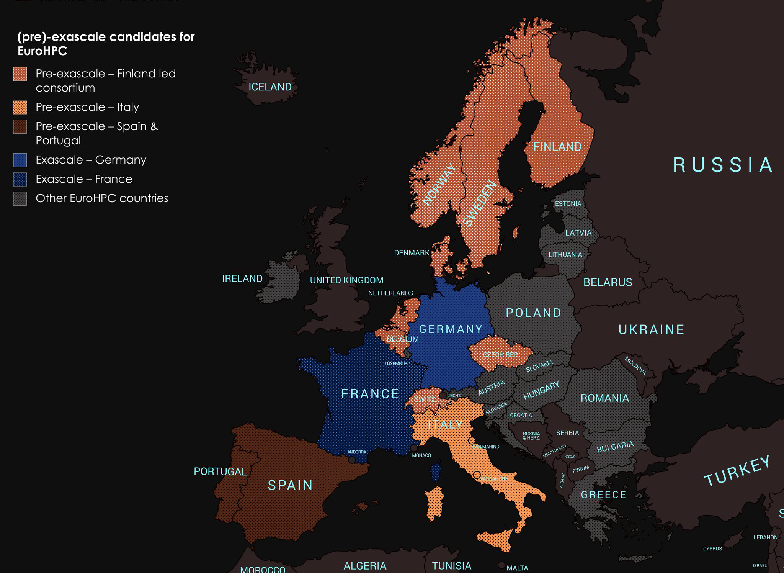
European HPC
HPC landscape
EuroHPC
EuroCC
DeiC
Creation of an HPC ecosystem in Europe
Competence Center Denmark

Slide 12
Competence Center
User:
Student
Researcher
Research group
SME
Institutions
HPC Hardware
Software
Training
Events
Resources
Facilitation
Knowledge sharing
Dissemination
HPC in industry
Support
Application
European HPC
Resources and
training
Collaboration
Competence Center DK

Slide 13
Content
Who am I?
What is HPC?
Why HPC?
HPC Landscape
Five HPC Infrastructures
Getting resources
Support

Slide 14
HPC Types
HPC infrastructure
DENMARK NATIONAL HPCs
I – Interactive HPC
Type 1-4: DeiC machines
Type 5: European machine
Access through DeiC
Type 1-3: Operational
Type 4: Operational late 2021
Type 5: Pilot phase
II – Throughput HPC
III – Large memory HPC
IV – Accelerated HPC
LUMI
V – Capability HPC

Slide 15
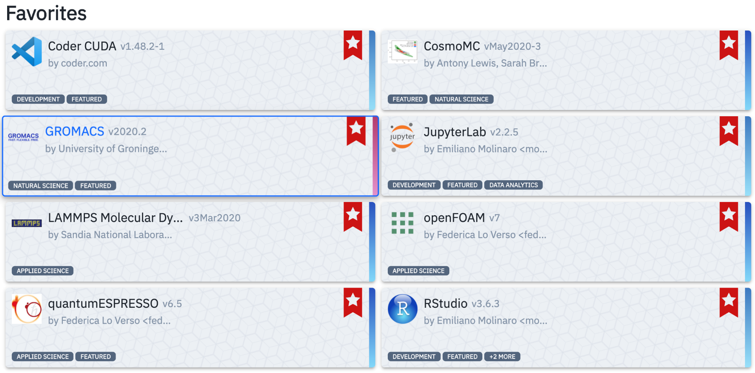
HPC Types
HPC infrastructure
DENMARK NATIONAL HPCs
I – Interactive HPC
User-friendly access
Pre-installed programs
Other programs can be added
GPUs
II – Throughput HPC
III – Large memory HPC
IV – Accelerated HPC
LUMI
V – Capability HPC
Website: https://interactivehpc.dk/#/

Slide 16
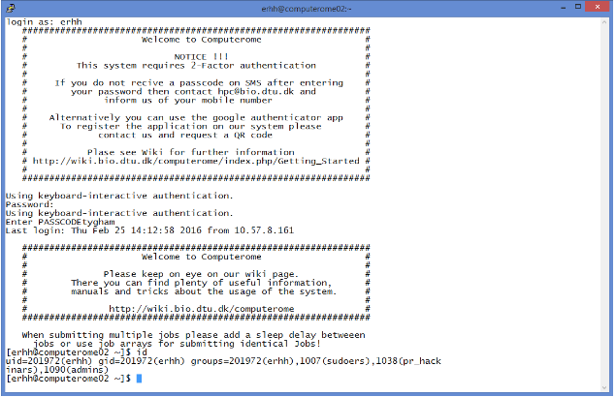
HPC Types
HPC infrastructure
DENMARK NATIONAL HPCs
I – Interactive HPC
Many parallel tasks on various CPUs and nodes
Shell secure login, i.e. no interactive access
Software can be added in protected environment
Wide range of nat/tech sciences applications
II – Throughput HPC
III – Large memory HPC
IV – Accelerated HPC
CPU
CPU
CPU
CPU
CPU
CPU
CPU
CPU
LUMI
V – Capability HPC

Slide 17
HPC Types
HPC infrastructure
DENMARK NATIONAL HPCs
I – Interactive HPC
Big memory nodes with large RAM
Memory on the same node
Should also offer an easy interface to access
Ideal for large problems with intensive memory access
II – Throughput HPC
III – Large memory HPC
IV – Accelerated HPC
CPU
CPU
LUMI
V – Capability HPC
1 node with 4TB RAM

Slide 18
HPC Types
HPC infrastructure
DENMARK NATIONAL HPCs
I – Interactive HPC
Accelerators such as
FPGA
In-memory computation
In-storage computation
Low-latency
Operative from late 2021
HPC laboratory
II – Throughput HPC
III – Large memory HPC
Input data to process
CPU
IV – Accelerated HPC
Output results
LUMI
V – Capability HPC

Slide 19
HPC Types
HPC infrastructure
DENMARK NATIONAL HPCs
I – Interactive HPC
Accelerators such as
FPGA
In-memory computation
In-storage computation
Low-latency
Operative from late 2021
HPC laboratory
II – Throughput HPC
III – Large memory HPC
Input data to process
Input memory results
CPU
IV – Accelerated HPC
Request memory calculations
Output CPU results
Accelerates
Logic ops
LUMI
V – Capability HPC

Slide 20
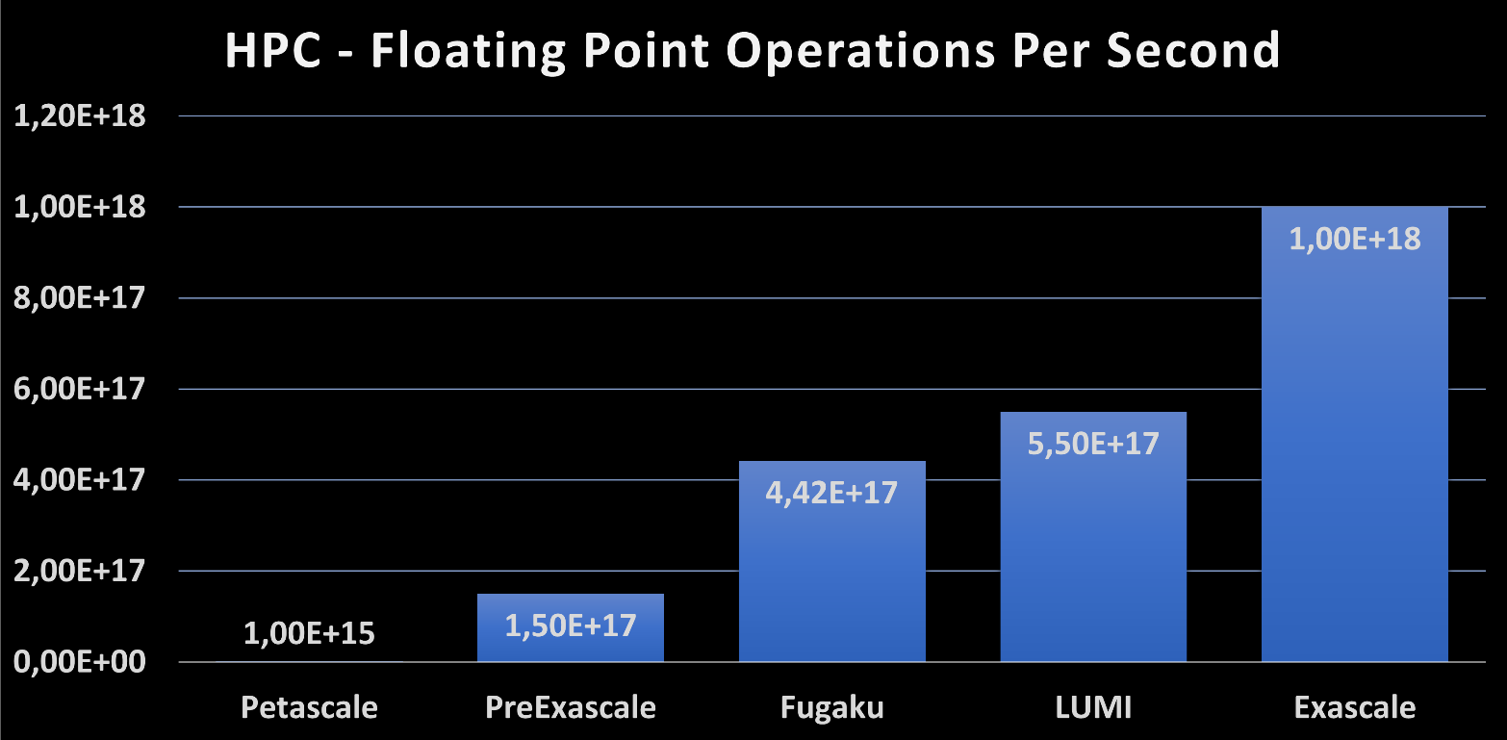
HPC Types
HPC infrastructure
DENMARK NATIONAL HPCs
I – Interactive HPC
Pre-exascale raw computational capability
Many layers of memory types
Exploits AMD CPUs and GPUs with increased bandwidth
HIP dialect (and not CUDA) to run AMD instinct GPUs
Operative from Q3/2021-Q1/2022
II – Throughput HPC
III – Large memory HPC
World’s
Fastest
IV – Accelerated HPC
LUMI
V – Capability HPC

Slide 21
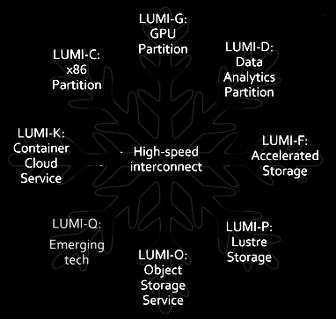
HPC Types
HPC infrastructure
AMD Instinct
GPUs
DENMARK NATIONAL HPCs
I – Interactive HPC
200K AMD Epic
CPUs
Interactive
Partition
II – Throughput HPC
III – Large memory HPC
Fast 7PB storage
IV – Accelerated HPC
Parallel FS
Storage 80PB
LUMI
V – Capability HPC
Ready for
Quantum
Technologies
Encrypted Storage 30PB
From lumi-supercomputer.eu

Slide 22
Content
Who am I?
What is HPC?
Why HPC?
HPC Landscape
Five HPC Infrastructures
Getting resources
Support

Slide 23
Apply – your way to HPC resources
System for resources assignment:
Only 2021: contact front office
From 2022: periodical application system with evaluation
Expected application window: January-Feburary 2022
Contact to ask for resources:
Facilitator – first contact for guidance, application, resources, knowhow, … Rasmus at rbj@chem.au.dk
Local university front office – applications, support, technical help Front office list
Resources available:
Sandbox for testing and getting started (weekly evaluation) Sandbox request page
Type 1 Sandbox: 1,000 Dkk free
A Grendel sandbox available for AU
Facilitator
Front office
User
National committee
(DeiC)
Local committee (AU)
EuropeanHPC
National HPC
https://www.deic.dk/en/supercomputing/Apply-for-HPC-resources

Slide 24
Content
Who am I?
What is HPC?
Why HPC?
HPC Landscape
Five HPC Infrastructures
Getting resources
Support

Slide 25
Support Layers
Support
Facilitator (competence center):
Choice of hardware, software, resources, gathering of knowhow, getting up to speed
Possible interface to support
Application support
Front office:
Evaluate resource allocation
Standard support and technical questions
Can redirect to back office for complex issues
Back office:
Coding/software issues
Complex technical problems
Setting up HPC environment
User
User
Facilitator
Facilitator
Front office
Front office
Back office
Each university has both local front and back offices on-site. Additional central/coordinating back office at DeiC

Slide 26
Example: Research Project
Support
User
Research project
Sandbox request
Test resource usage
Apply for HPC resources
Assigned HPC resources
Facilitator
Front office
Back office

Slide 27
Support
Example: Teaching Setup
User
Lecturer
Setup a course account
Apply for resources
Obtain resources
Facilitator
Front office
Back office

Slide 28
Wrapping up
System for national and European HPC
Both advanced and new users
Research, teaching, student projects
A step up in computational resources
Access through periodic application
Sandbox for testing and benchmarking
Technical and application support

Slide 29
Questions, Comments, Discussion
Contact: rbj@chem.au.dk
HPC webpage: deic.dk

Slide 31
Technicals

Slide 32
Coding on specific hardware
CPUs and GPUs
 | CPU type | GPU type
Type 1 | Intel | Nvidia K40 and V100
Type 2, AU | Intel, AMD Epyc | Nvidia V100
Type 2, DTU | Intel | Nvidia V100
Type 3 | AMD Epyc | -
Type 4 | AMD Epyc | -
Type 5 | AMD Epyc | AMD Instinct

Slide 33
Type 1 Hardware - UCloud
Coding on specific hardware
CPUs and GPUs
Node | CPU type | Clock Frequency | vCPUs | Memory | GPU type
u1-standard | 2x Intel(R) Xeon(R) Gold 6130 | 2.10 GHz | 32 | 384 GB
u1-fat | 2x Intel(R) Xeon(R) Gold 6130 | 2.10 GHz | 32 | 768 GB
u1-gpu | 2x Intel(R) Xeon(R) Gold 6230 | 2.10GHz | 40 | 192 GB | 4x NVIDIA Tesla V100 SXM2 Volta GPUs Accelerators 32GB
u2-gpu | AMD EPYC 7F72 | 3.2 GHz | 48 | 2048 GB | 8x NVIDIA Tesla A100 PCIe GPUs Accelerators 40 GB

Slide 34
Type 1 Hardware - Claaudia
Coding on specific hardware
CPUs and GPUs
Type | Count | CPU type | Cores pr. node | Total cores | RAM pr. node | Total RAM | Additional specs.
Generic | 11 | AMD | 64 cores | 704 | 512 GB | ~ 5,6 TB | InfiniBand
CLAAUDIA Managed | 9 | AMD | 64 cores | 576 | 512 GB | ~ 4,6 TB | InfiniBand
Generic | 19 | AMD | 64 cores | 1216 | 1024 GB | ~ 19,4 TB
Generic | 1 | AMD | 64 cores | 64 | 2048 GB | ~ 2,0 TB
CLAAUDIA Managed | 1 | AMD | 64 cores | 64 | 2048 GB | ~ 2,0 TB
CLAAUDIA Managed | 1 | AMD | 32 cores | 32 | 256 GB | 256 GB
CLAAUDIA Managed | 1 | AMD | 64 cores | 64 | 512 GB | 512 GB
CLAAUDIA Managed | 2 | AMD | 32 cores | 64 | 512 GB | ~ 1,0 TB
CLAAUDIA Managed | 21 | AMD | 16 cores | 336 | 256 GB | ~ 5,3 TB
CLAAUDIA Managed | 1 | AMD | 24 cores | 24 | 512 GB | 512 GB
CLAAUDIA Managed | 1 | AMD | 64 cores | 64 | 512 GB | 512 GB
CLAAUDIA Managed | 1 | AMD | 64 cores | 64 | 256 GB | 256 GB
Generic | 18 | Intel | 36 cores | 648 | 384 GB | ~ 6,7 TB | InfiniBand
Generic | 10 | Intel | 36 cores | 360 | 768 GB | ~ 7,6 TB
Search cloud | 5 | Intel | 16 cores | 80 | 128 GB | 640 GB | 16 TB SSD per node
Total | 102 |  |  | 4360 |  | ~ 55 TB

Slide 35
Type 2 Hardware
Coding on specific hardware
CPUs and GPUs
 | GenomeDK | Computerome2 | Sophia
CPUs | AMD EPYC Rome 7452 | Xeon Gold 6230 Cascade Lake | AMD EPYC 7351
Cores pr. node | 64 | 40 | 32
Memory | 512 GB | 192 GB | 128 GB
Network | 100 Gb/s Infiniband | 100 Gb/s Infiniband | 100 Gb/s Infiniband
Storage | 11.5 PB | 8 PB | 1 PB
Queue system | SLURM | Torque/Moab | SLURM
Security | ISO 27001-compliant | ISO 27001-compliant | UNIX not GDPR-compliant

Slide 36
Type 2 Hardware - Grendel
Coding on specific hardware
CPUs and GPUs
Partition | Number of nodes | Number of CPUs and model | Number of Cores pr. Node | Clock Speed | Year of acquisition
q8 | 10 | 2 AMD Opteron 2356 CPUs | 8 | 2.3 GHz | 2008
q12/q12fat | 96 | 2 Intel Xeon X5650 CPUs | 12 | 2.7 GHz / 2.9 GHz | 2011
q16 | 58 | 2 Intel Xeon E5-2670 CPUs | 16 | 2.6 GHz | 2012
q20 | 98 | 2 Intel Xeon E5-2680 v2 CPUs | 20 | 2.8 GHz | 2014
q24 | 16 | 2 Intel Xeon E5-2680 v3 CPUs | 24 | 2.5 GHz | 2016
q28 | 96 | 2 Intel Xeon E5-2680 v4 CPUs | 28 | 2.4 GHz | 2016
q36 | 40 | 2 Intel Xeon Gold 6140 CPUs | 36 | 2.3 GHz | 2018
q40 | 49 | 2 Intel Xeon Gold 6230 CPUs | 40 | 2.1 GHz | 2019
q48 | 106 | 2 Intel Xeon Gold 6248R CPUs | 48 | 3.0 GHz | 2020
qfat | 1 | 2 Intel Xeon Gold 6230 CPUs, 1.5 TB memory. | 40 | 2.1 GHz | 2019
qgpu | 48 | 2 Intel Xeon Gold 6240 CPUs, and 2 Nvidia V100-16GB GPUs | 36 | 2.6 GHz | 2019
qgpuo | 10 | 2 Intel Xeon E5-2680 v3 iCPUs and 2 Nvidia K40-12GB GPUs / 2 Intel Xeon Gold 6140 CPUs and 2 Nvidia P100-12GB GPUs | 24/36 | 2.5 GHz/2.3 GHz | 2016/2018

Slide 37
Type 3 Hardware
Coding on specific hardware
CPUs and GPUs
Summary | Compute nodes | CPU cores | Memory | Storage | Interconnect
 | 4 | 512 | 16 TiB | 1 PiB | 100 Gbps Infiniband EDR
Compute nodes | CPUs | Clock Speed | Cores | Memory
 | 2x AMD EPYC 7742 | 2.25 GHz | 64 | 4096 GB DDR4-3200 LRDIMM & 480 GB SSD | 480 GB SSD
Frontend | CPUs | Clock Speed | Cores | Memory
 | 2x AMD EPYC 7282 | 2.8 GHz | 16 | 128 GB DDR4-3200 & 480 GB SSD | 480 GB SSD

