Slide 1
Staff meeting department of biology march 19th 2024

Slide 2
agenda
1. Creativity in research: A perspective from the Center for Electromicrobiology - Ian Marshall (15 min)
2. News from the Department – Anne Mette Siem (Rejs Ud – new requirements), Angela Fago (Annual Conference, Graduation Party) (5 min)
3. New Financial Model at NAT: consequences for Biology. Q&A - Hans Brix
Coffee, cake and networking

Slide 3
Nurturing creativity at

Slide 4

Think back to the last creative idea you had about your research. To the best of your recollection, where were you when you had this idea?
24 responses total
Zero responses: Exercising, cooking, shopping, watching TV, out with friends, on your phone, prayer or meditation, can’t remember

Slide 5
What primarily inspired the last creative idea that you had about your research?
24 responses total
Zero responses: Someone else’s data, video or podcast, cannot remember

Slide 6


creativity at cem
Social
Independent

Slide 7
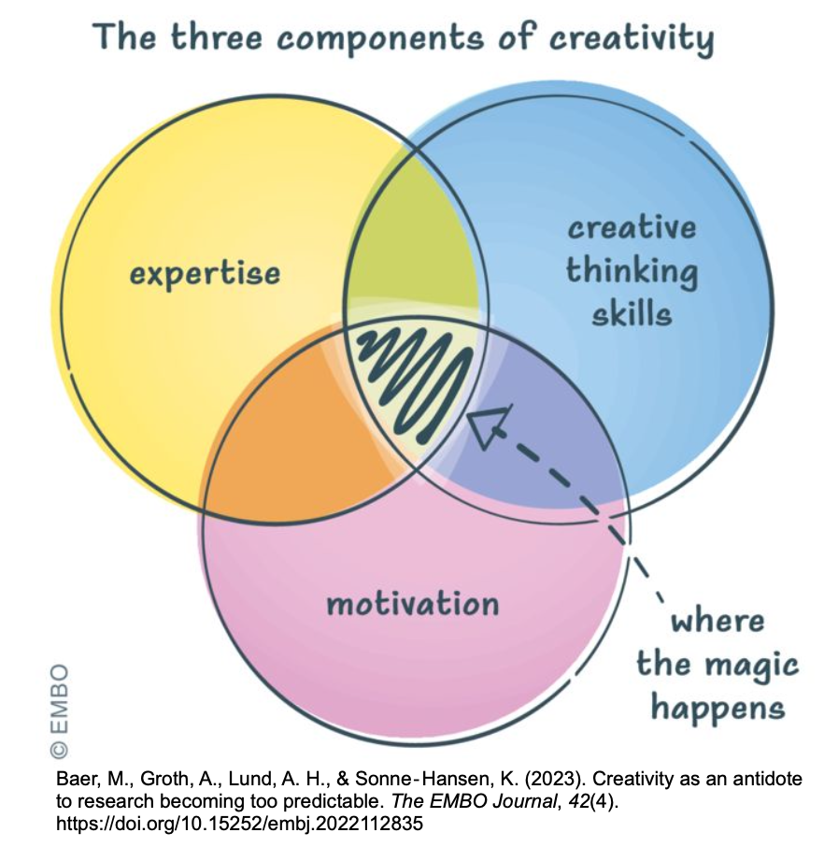
Even ideas born independently need a social context to thrive
Does this idea fit into CEM’s overall themes (motivation)?
  CEM has a broad cross-disciplinary focus with openness to new ideas built in
Do we have the expertise to carry out this idea?
  Collaborations – internal and external

Slide 8
Opportunities for interaction
Biweekly meetings (two presenters every two weeks)
Monthly PI project meetings
Topic-driven, project-driven meetings (ad hoc or regular)
CEM assemblies
  Whole-day meetings held twice a year
Annual retreat
  2-3 day offsite meeting
Other meetings with large CEM participation
  International Cable Bacteria Workshop, Electromicrobiology Conference, other conferences (ISMET, ISME, etc.)

Slide 9
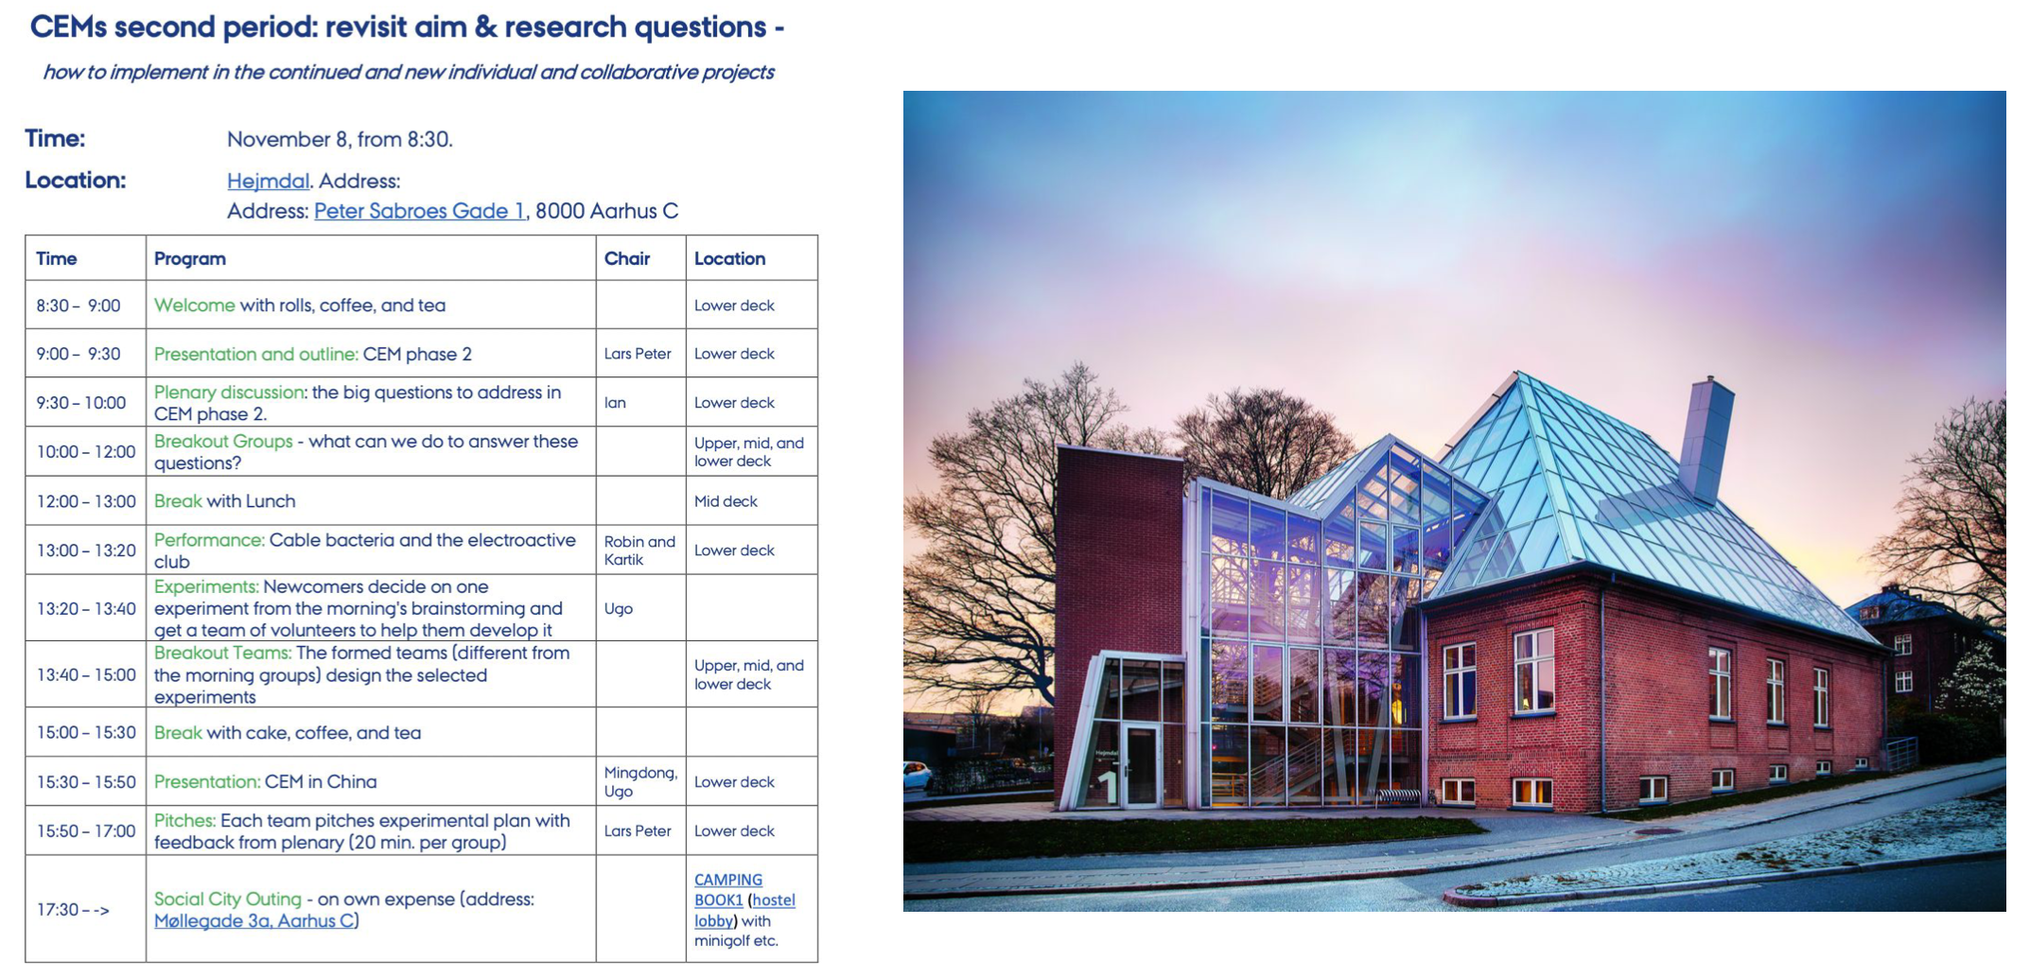
Example assembly schedule

Slide 10
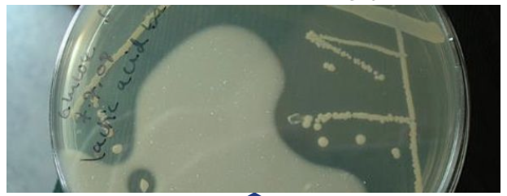
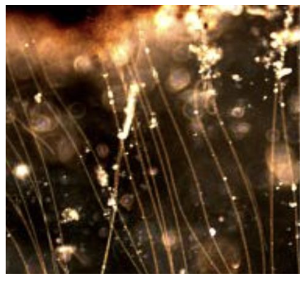
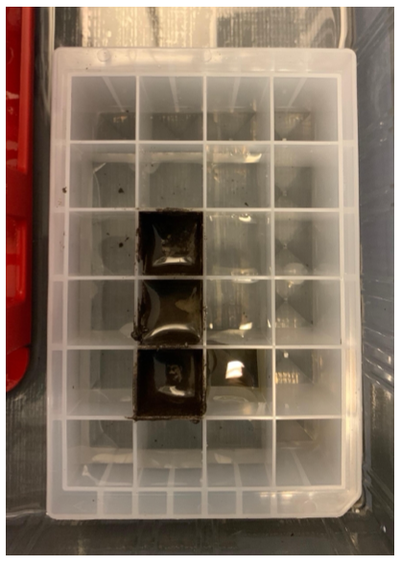
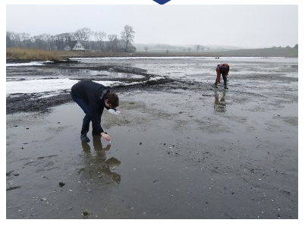
Cable bacteria provoke creativity because they’re weird
Microbiologists
Physicists/Chemists/Molecular Biologists
Somewhere between the environment and a pure culture
You want me to work with mud?

Slide 11

Balancing freely creative basic research and applied research
Why waste our precious basic research budget on applied research?
There are plenty of alternative funding sources out there when we find practical applications
We take this word seriously

Slide 12

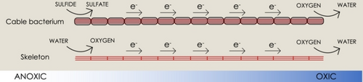
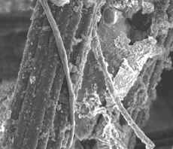
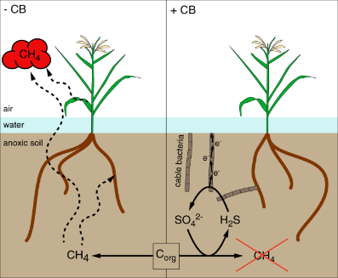




Practical ideas arise from a creative, interactive environment
Lake Restoration (Andreas Schramm, Ugo Marzocchi)
Cable bacteria produce O₂
Cable bacteria reduce methane from rice plants
Cable bacteria interacting with electrodes
New catalysts for CO₂ fixation systems (Ian Marshall)
Field-scale testing (Vincent Scholz)
Cable bacteria for energy conversion/storage (Kartik Aiyer)

Slide 13
News from the department
Anne-Mette + Angela

Slide 14
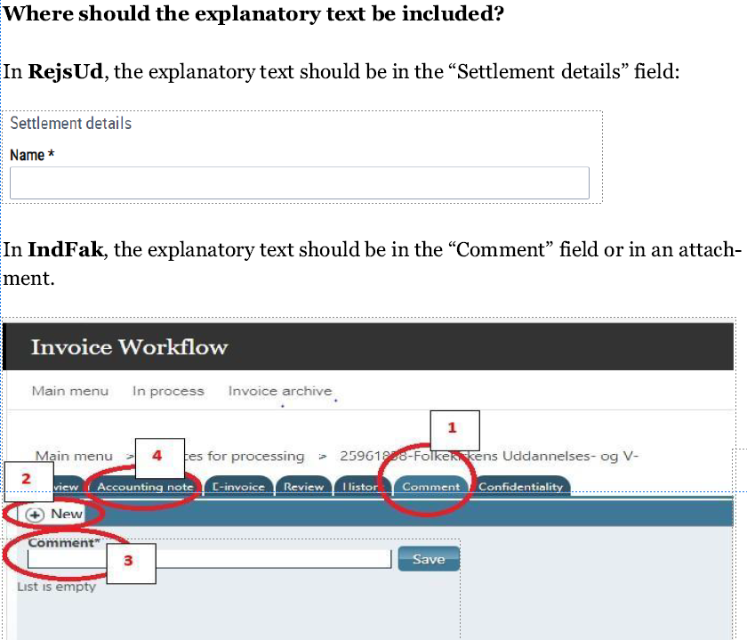
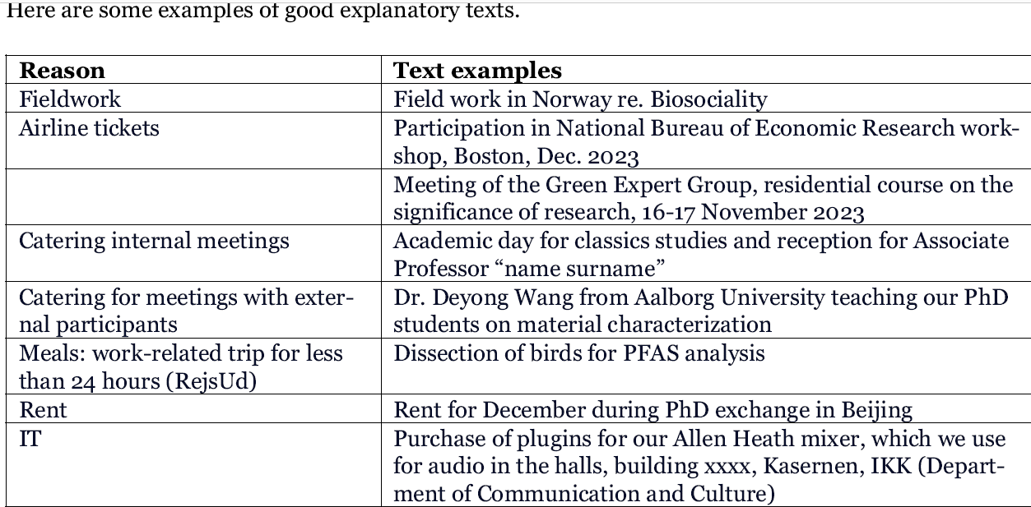
RejsUd (travel/expense claims) and IndFak (invoices)
The 2022 and 2023 audit recommendation: Provide a clear description of the purpose of costs – see examples/clarifications of descriptions in memo from AU Finance (will be sent out after the staff meeting and can also be found on the BIO staff webpage)
NOTE (documentation besides the receipt/invoice)
Claims regarding meetings/conferences must be documented with an agenda or conference programme
Meals/catering: names and affiliation on all participants
PhD defense and inaugural/resignation lectures: invitation/notice
Rent payments: rental agreement
Private expenses: bank statement
Better to write too much than too little to avoid too much administration

Slide 15
upcoming events
Alumne dag - 21st March, Lake auditorium https://bio.au.dk/samarbejde/alumner/alumnedag
Department of Biology Annual Conference - 11th June Registration is open!
Aud. F + vandrehallen (detailed program will follow)
Invitation to present their research: PhD students, post docs, etc. up to professors (TAP are invited to attend)
15-min talks, posters, 2-min madness, 1 keynote speaker, poster prize
Graduation Day – Master degree – 28th June (venue will follow)
from 16.00 (keep in mind when planning Master exams!)

Slide 16
Some upcoming deadlines
Contact Maria B. Nielsen if you plan to apply to any of these calls – and get peer reviewer feedback
Please send your submitted applications to Maria B. Nielsen for uploading to ReAp
DFF
Ordinary call - FP1 17th April 2024
Thematic Research – Climate - FP1 and FP2
1) Independent Green Research 30th May 2024
2) Arctic Research – Climate change and sustainable arctic communities 4th June 2024
Nordforsk
Sustainable Development of the Arctic (pre-proposal) 4th June 2024
Sustainable fisheries from healthy seas 28th May 20204
See other calls at: https://bio.staff.au.dk/research-support/funding/find-funding-opportunities/
Sign up for newsletter from the research support unit at https://medarbejdere.au.dk/administration/stoette-til-din-forskningspraksis/forskningsstoetteenheden and check for info and events

Slide 17
New Financial Model at NAT: consequences for Biology. Q&A
Hans B.

